Slide 1

WELCOME
We’ll get started momentarily

Slide 2
AI FOR LEADERS
[Enterprise] + GA

Slide 3
Meet Your Instructors
NAME, TITLE

Slide 4
Meet Your Instructors
NAME, TITLE

Slide 5
Summarize the AI landscape - where it’s been, where it is, and where it’s going
Identify and discuss key ethical and legal considerations related to generative AI
Develop a mental model for evaluating and identifying opportunities in generative AI technologies

Slide 6
AI for Leaders
The AI Landscape

Slide 7
Recap: What is Generative AI?
Generative AI is the most recent advancement in the field of machine learning
Generative AI technologies are capable of creating new content, ranging from text to images and video
The most popular generative AI technologies are called Large Language Models, or LLMs for short
Put simply, LLMs are models that specialize in predicting the next word in a sentence.
Notes:
PURPOSE:
Provide a concise overview of Generative AI and its relationship with Large Language Models (LLMs).
TALKING POINTS:
• Generative AI represents the cutting edge in machine learning, expanding the boundaries of what machines can create.
• This technology has the ability to generate a wide array of new content, including text, images, and videos, simulating human-like creativity.
• LLMs are a subset of generative AI that focus on text generation, predicting subsequent words based on context, thus simulating understanding and composition of language.
TEACHING TIPS:
• Draw parallels between human creativity and AI content generation to help learners relate to the technology.
• Use examples of LLMs in action, like writing assistance, to demonstrate their capabilities.
• Emphasize the "predictive" nature of LLMs, using the analogy of predictive text on smartphones to make it more tangible.

Slide 8
5 Minutes
You’ve Heard A Lot About GenAI Already, But…
What have you experienced with GenAI?
What concerns do you have with AI?
What burning questions do you have?
Notes:
PURPOSE:
Engage the audience in a reflective conversation on their experiences, concerns, and curiosities regarding Generative AI.
TALKING POINTS:
• Encourage sharing of personal experiences with Generative AI to understand the variety of interactions within the group.
• Open the floor to any concerns participants may have about AI, such as ethics, bias, or job displacement, to acknowledge and address potential apprehensions.
• Invite "burning questions" the audience has, which can reveal their depth of interest and areas of curiosity about Generative AI.
TEACHING TIPS:
• Create an inclusive environment where all experiences and viewpoints are valued, encouraging quieter participants to share.
• Be prepared to provide informative responses to concerns, bringing in current research and expert opinions.
• Use the questions as a springboard for deeper discussion, noting recurring themes for follow-up in later sessions.

Slide 9
LET’S ASK CHATGPT WHAT IT THINKS.
Notes:
Purpose - An ice breaker and a chance to show ChatGPT early.

Slide 10
What Executives Need To Know
What are the legal & compliance needs?
Do we wait, or act now?
Incremental or Transformational change?
What is the long-term market outlook?
How much change management is required?
What infrastructure is required?
Notes:
Note: Andrej Karpathy was one of the original members of OpenAI, and rejoined the team in February 2023.
Transition: The breakthrough has come through the fact that we are now able to train models on such a huge scale, and this is where “Large” comes in.
PURPOSE:
Guide executives in understanding the key considerations for integrating AI within their business strategies.
TALKING POINTS:
• Highlight the importance of understanding the evolving legal and compliance landscape around AI to mitigate risks.
• Stress the urgency of deciding whether to be an early adopter of AI technology or to take a wait-and-see approach.
• Discuss the potential impact of AI on the market and how it might alter the competitive landscape in the long term.
• Evaluate the degree of change management needed to successfully implement AI technologies within the organization.
• Consider whether AI will lead to incremental improvements or necessitate a transformational change in business operations.
• Identify the infrastructure requirements for adopting AI, considering both technical and human resource investments.
TEACHING TIPS:
• Use real-world case studies to illustrate the consequences of legal and compliance decisions related to AI.
• Facilitate a pros and cons discussion on early adoption versus a delayed approach to implementing AI.
• Encourage forward-thinking on market trends to anticipate how AI could offer a competitive advantage.
• Emphasize the importance of a well-structured change management plan tailored to the organization's readiness for AI.
• Prompt a strategic dialogue on how AI can either incrementally improve processes or redefine business models.
• Discuss the importance of robust infrastructure to support AI initiatives, including technical systems and skilled personnel.

Slide 11
AI is quite possibly the most important – and best – thing our civilization has ever created, certainly on par with electricity and microchips, and probably beyond those.
Marc Andreessen, Co-founder Andreessen Horowitz
Notes:
PURPOSE: This slide aims to underscore the transformative potential of AI, aligning it with other game-changing technologies like electricity and microchips to deepen our understanding of its potential business applications and impact.
TALKING POINTS:
Marc Andreessen is no stranger to technological revolutions, having been involved in shaping the internet.
He equates the potential of AI to groundbreaking advancements like electricity, suggesting AI could power a fourth industrial revolution.
However, it's important to approach the hype with a balanced view, given that not all hyped-up technologies live up to their promises.
TEACHING TIPS
Marc Andreeson created the first widely used web browser, Mosaic, and so has seen multiple hype cycles before. And yet he is arguing the that AI will power a fourth industrial revolution after those of steam, electricity, and information technology.
While we should remain sceptical about any hyped up technology - remember NFTs? - we think it may not be quite so fanciful to imagine that the impact on the world of work could ultimately be as huge as the internet, ecommerce, or even the humble spreadsheet.

Slide 12
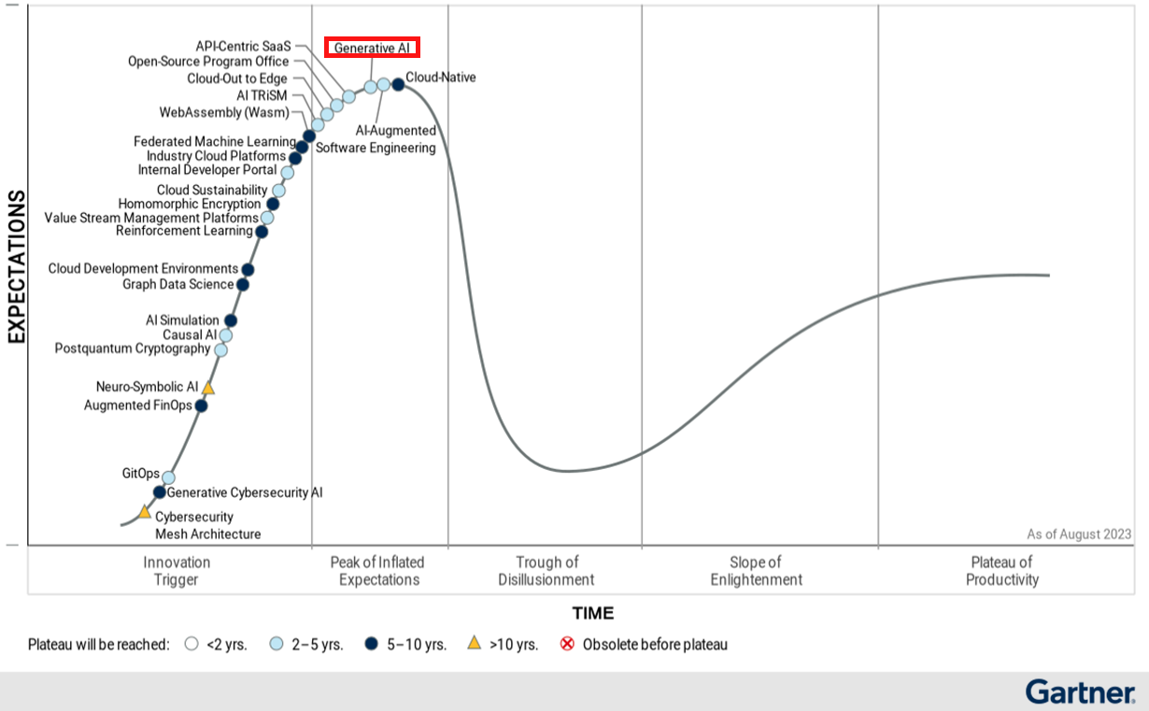
We are at peak hype, so should we still explore genAI?
Notes:
PURPOSE:
To critically evaluate the decision to invest in Generative AI amidst the current heightened excitement around the technology.
TALKING POINTS:
• Identify the phenomena of the hype cycle and where Generative AI currently stands, emphasizing the pattern of inflated expectations.
• Examine the potential risks and rewards of investing in a technology at its hype peak, including the possibility of a subsequent disillusionment phase.
• Discuss strategic approaches to investment in Generative AI that can weather the hype cycle's volatility and lead to long-term gains.
TEACHING TIPS:
• Use historical examples of technologies that have gone through the hype cycle to give context to the current status of Generative AI.
• Encourage critical thinking by discussing the implications of acting on hype versus evidence-based decision-making.
• Prompt participants to consider not just the current state of the technology but also its trajectory and potential to reach the plateau of productivity.

Slide 13
YES.
“CEOs should consider exploration of generative AI a must, not a maybe.”
-McKinsey
Notes:
Note: We will breakdown each word in “LLM” one-by-one in this lesson. So the first thing to say is that large language models are models but what do we actually mean by models?

Slide 14



The AI Landscape
Foundation Models
Emerging AI Ecosystem
Infrastructure
& Talent

Slide 15
FOUNDATION MODELS
Foundation Models
Emerging AI Ecosystem
Infrastructure
& Talent
When we talk about LLMs or AI Art, we’re talking foundation models.
Deep learning models trained on vast quantities of unstructured, unlabeled data.
Notes:
PURPOSE:
Clarify the concept of Foundation Models and their role in the context of LLMs and AI-generated art.
TALKING POINTS:
• Explain that Foundation Models are a broad category of AI models which underpin various applications including LLMs and AI-generated art.
• Emphasize that these models are trained on large volumes of data that is often unstructured and unlabeled, highlighting the scale of data required.
• Clarify that despite their general-purpose nature, Foundation Models can be fine-tuned for a wide range of specific tasks.
TEACHING TIPS:
• Use analogies to help the audience grasp the scale and scope of the data used in training Foundation Models, such as comparing it to learning from the content of an entire library.
• Discuss the implications of the term "foundation," suggesting that these models provide a base upon which specialized functionalities can be built.
• Consider providing examples of how Foundation Models have been adapted for various domains, stressing their versatility and transformative potential.

Slide 16
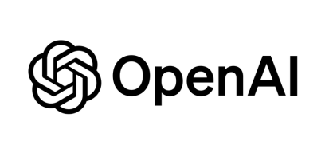





PROPRIETARY MODELS:
Foundation Models
Emerging AI Ecosystem
Infrastructure
& Talent
OPEN-SOURCE MODELS:

Slide 17
When to Use Proprietary Models:
Foundation Models
Emerging AI Ecosystem
Infrastructure
& Talent
The top performing model is required
Talent to configure & maintain is low
Low-code options (plugins)
Lacking the proper infrastructure to run a model
Notes:
PURPOSE:
Educate on the scenarios where opting for proprietary AI models is beneficial for an organization.
TALKING POINTS:
• Underline the necessity of choosing proprietary models when the application demands the highest level of performance.
• Highlight the advantage of proprietary models when in-house expertise in AI is limited, as these often come with support and simpler integration tools.
• Point out that proprietary models often offer low-code or no-code solutions which can be advantageous for quick deployment and ease of use.
• Discuss the infrastructure requirements of AI models and how proprietary solutions can be more feasible for organizations without the necessary infrastructure.
TEACHING TIPS:
• Provide examples of proprietary models by leading tech companies like OpenAI, Microsoft, and Google to illustrate the discussion.
• Stress the importance of evaluating the trade-offs between proprietary and open-source models, including cost, flexibility, and proprietary lock-in risks.
• Encourage thinking about the long-term strategic fit of proprietary models within the organization's tech ecosystem.

Slide 18
When to Use Open-Source Models:
Foundation Models
Emerging AI Ecosystem
Infrastructure
& Talent
You need control of your data (running on-prem)
More control of model training and fine-tuning
Potentially lower long-term operating costs
Notes:
PURPOSE:
Explain the advantages of using open-source AI models for certain organizational needs and situations.
TALKING POINTS:
• Emphasize the significance of data sovereignty and how open-source models can be more suitable for companies that require on-premises data storage.
• Discuss the flexibility open-source models offer in terms of customization and fine-tuning to meet specific needs.
• Outline the potential for reduced long-term operating costs associated with open-source models compared to proprietary solutions.
TEACHING TIPS:
• Highlight case studies or examples where businesses benefited from the adaptability of open-source models.
• Encourage a discussion on the importance of having the right skill set within the team to manage and customize these models effectively.
• Point out the commitment required to maintain and update open-source models, ensuring that they remain secure and effective over time.

Slide 19
A New Ecosystem
IMPLICATIONS:
More procurement work
More build vs. buy decisions
More vendor assessments
More infrastructure
Foundation Models
Emerging AI Ecosystem
Infrastructure
& Talent
Services
Software
Model Hubs/
ML Ops
Foundation
Models
Infrastructure
Notes:
PURPOSE:
To explain the layered nature of the new AI ecosystem and its implications for businesses.
TALKING POINTS:
• Outline the multi-tiered structure of the emerging AI ecosystem, from foundational infrastructure to services.
• Explain that as companies engage with this ecosystem, they will encounter increased procurement complexity.
• Discuss the necessity of making strategic decisions between developing in-house solutions or purchasing them, often referred to as build vs. buy decisions.
• Understand that assessing vendors becomes a crucial skill as the number of specialized service providers grows.
• Highlight the need for expanded infrastructure to support advanced AI models and operations.
TEACHING TIPS:
• Use the diagram to visually represent the complexity and interconnectivity of the different layers in the AI ecosystem.
• Prepare to guide discussions on how to navigate procurement in this context, including evaluating cost, scalability, and long-term benefits.
• Encourage participants to consider the implications of each layer for their own business needs, particularly in terms of investment and potential return on investment.

Slide 20
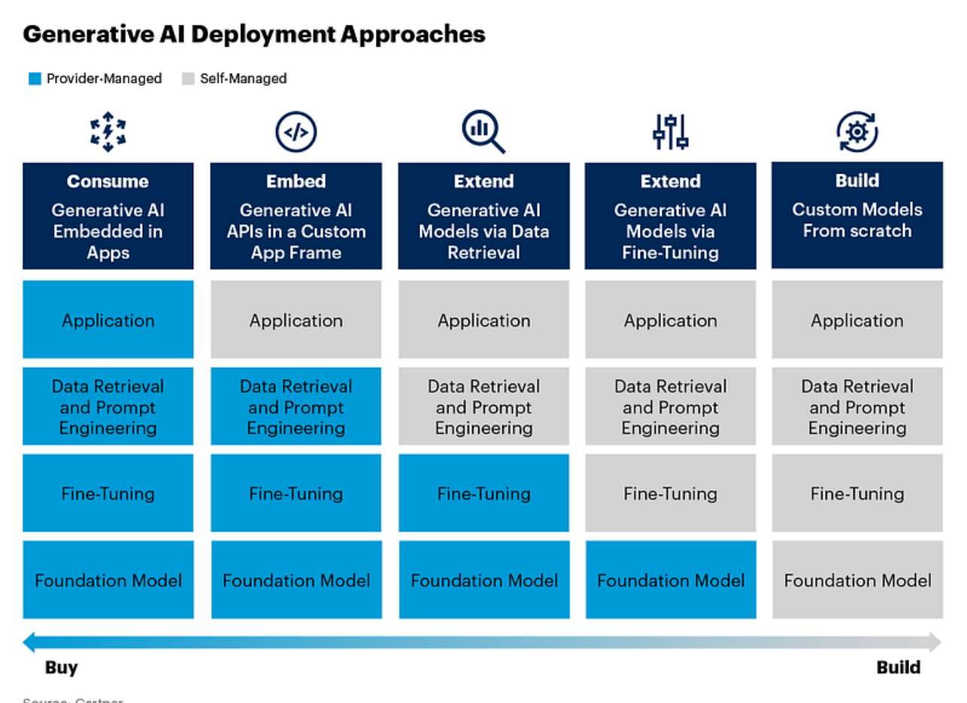
Executives Are Investing in AI Infrastructure
Foundation Models
Emerging AI Ecosystem
Infrastructure
& Talent
Using LLMs can require a little or a lot of infrastructure.
Notes:
PURPOSE:
Describe the range of investment in infrastructure that executives must consider when integrating LLMs into their business processes.
TALKING POINTS:
• Illustrate the spectrum of deployment approaches for generative AI, from provider-managed applications to building custom models from scratch.
• Explain that the infrastructure investment required can vary significantly depending on the chosen deployment approach.
• Emphasize that while using pre-built LLMs may require minimal infrastructure, developing custom models necessitates a more robust setup.
TEACHING TIPS:
• Use this slide to discuss the importance of aligning the deployment approach with the company’s strategic goals and capabilities.
• Encourage participants to consider the balance between the upfront cost of infrastructure and the potential for long-term value creation.
• Highlight the importance of talent and expertise in managing the chosen infrastructure and ensuring the successful deployment of LLMs.

Slide 21
Changing Talent Requirements
Foundation Models
Emerging AI Ecosystem
Infrastructure
& Talent
Data Scientist: R&D to create a new model.
MLEngineer: Enables models to run at scale.
“Data Scientist was the sexiest title of the 2010’s.
ML Engineer is the sexiest title of the 2020’s.”

Slide 22
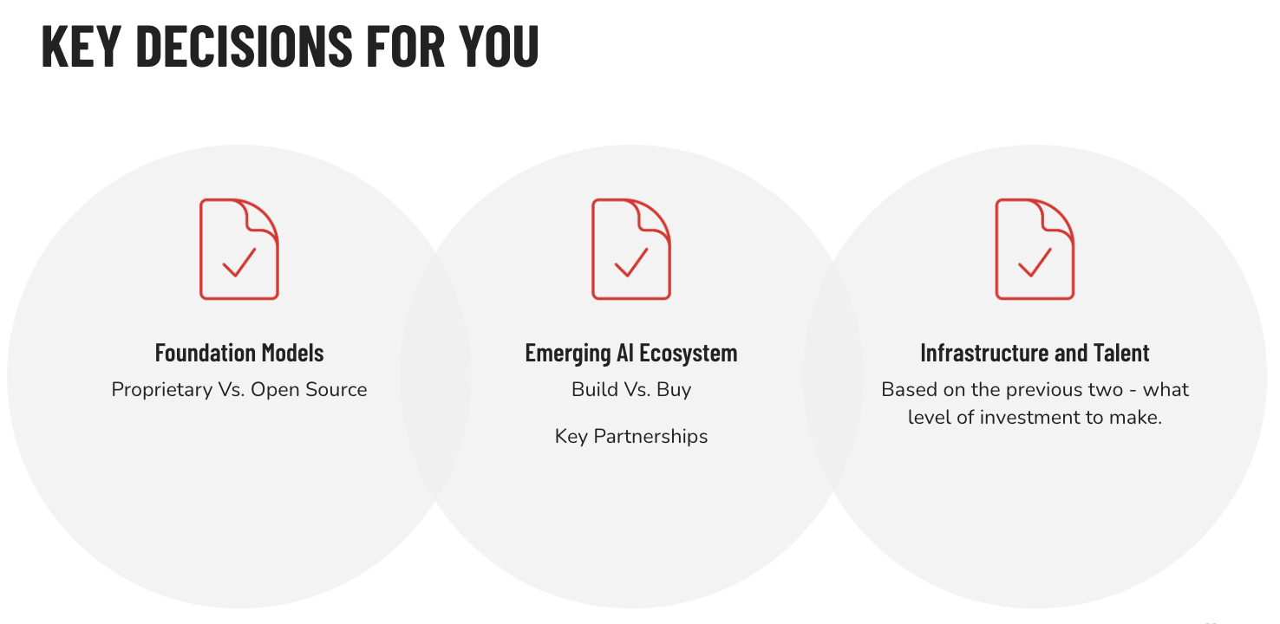
5 Minutes
The year is 2015. “Digital Transformation” is all the rage…
Much of today mirrors decisions from the 2010’s -
How did you approach digital transformation?
What lessons can we takeaway when considering?
Would you have moved faster? Slower?
Notes:
PURPOSE:
To engage participants in reflecting on past digital transformation efforts and derive lessons for current AI investments.
TALKING POINTS:
• Encourage sharing of personal or organizational experiences with digital transformation initiatives from the early 2010s.
• Foster a discussion on key learnings from past digital transformations that can inform present-day decisions in AI adoption.
• Explore whether a faster or more cautious approach to digital transformation might have yielded different outcomes, applying this insight to AI strategy.
TEACHING TIPS:
• Frame the discussion to compare past and present, emphasizing that while technology changes, the principles of strategic adoption often remain similar.
• Prompt participants to consider how foundational models, open versus proprietary choices, and infrastructure investments relate to their digital transformation experiences.
• Suggest that participants think about the balance between speed and due diligence in the context of rapidly evolving AI technologies.

Slide 23
AI for Leaders
Legal & Ethical Considerations

Slide 24
Data are generated through a process of abstraction, so any data are the result of human decisions and choices.
The implication is that data are never an objective description of the world.
Notes:
Data abstraction is the reduction of a particular body of data to a simplified representation of the whole. Abstraction, in general, is the process of removing characteristics from something to reduce it to a set of essential elements. To this end, data abstraction creates a simplified representation of the underlying data, while hiding its complexities and associated operations.

Slide 25
Where Does Bias Come From?
Any Generative AI model will reflect the biases of:
the training data
1
the humans who helped fine-tune the model
2
the people who provided feedback as part of the RLHF* stage
3
*reinforcement learning with human feedback
Notes:
PURPOSE:
- To explain the primary sources of biases in Generative AI models and emphasize the importance of responsible AI training and refinement.
TALKING POINTS:
- Training data biases: If the data used to train the AI is skewed or contains inherent biases, the model will inevitably mirror these flaws.
- Human influence: The individuals involved in refining and fine-tuning the AI contribute their own perspectives and potential biases.
- RLHF (Reinforcement Learning with Human Feedback): The biases of those giving feedback during the RLHF stage can indirectly shape the model's behavior and outputs.
TEACHING TIPS:
- Engage the audience with a real-world example of biased AI outputs, prompting a discussion on its root causes.
- Encourage participants to think about how to ensure diverse and unbiased input during each stage, reducing the chances of a biased AI model.

Slide 26
Statistical vs. Societal Bias
Statistical:
Why? Because our dataset does not accurately represent the world.
Who Can Fix It? The product development team, including data scientists, QA, Design, and Product.
Societal:
Why? Because our dataset represents the world where there is existing bias.
Who Can Fix It? Bias is baked into the data. Development team needs to be aware, but compliance, legal, and ethics experts may be needed.
Notes:
PURPOSE:
To differentiate between statistical and societal biases and identify the responsible parties for addressing these biases in data science.
TALKING POINTS:
• Statistical bias occurs when a dataset does not accurately reflect the real world, which can lead to skewed results in data analysis and model training.
• Societal bias is present when the dataset accurately reflects existing biases in society, implying that the problem lies within societal structures rather than data collection methods.
• The product development team, including data scientists, quality assurance, design, and product professionals, is typically responsible for rectifying statistical bias.
• Societal bias requires a broader approach involving compliance, legal, and ethics experts, highlighting the necessity for interdisciplinary efforts to address deep-rooted biases in data.
TEACHING TIPS:
• Use real-world examples to illustrate the impact of statistical and societal biases on AI and machine learning models.
• Encourage discussion on the responsibility of technologists to recognize and address both types of bias.
• Highlight the importance of diversity within development and ethics teams to ensure a wide range of perspectives when tackling biases.
Constructing a more unbiased dataset
Unfair datasets are the root cause of bias. Therefore, a direct approach to addressing algorithmic bias is reconfiguring unbalanced datasets. Using multiple data points can yield more accurate results while carefully eliminating data points that reflect past biases. However, this approach incurs significant costs.Another method is to correct data imbalances by using more equitable data sources to ensure fair decision-making
Enhancing algorithmic transparency
Engineers write algorithmic models, but they often need help understanding the processes that AI undergoes to produce a specific outcome. Many algorithmic biases are difficult to fully understand because their techniques and methods are not easily visible. This leaves many people unaware of why or how they are discriminated against and lacks public accountability
Technological tools against bias
Data blending process. Blendoor is inclusive recruiting and staffing analytics software that mitigates unconscious bias. It takes candidate profiles from existing online job boards and applicant tracking systems to reduce unconscious bias. Blendoor “blends” candidate profiles by removing names, photos, and dates
Internal ethics governance
External supervision

Slide 27
CONSIDER HIRING AN AI ETHICIST

Slide 28

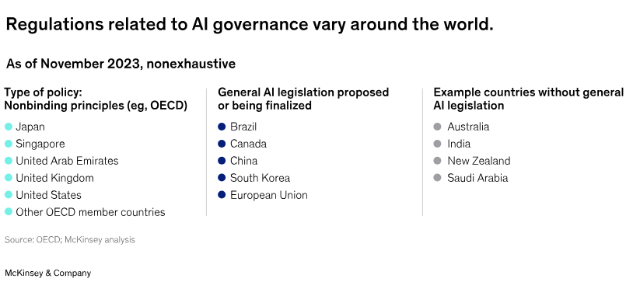
Regulations Haven’t Fully Caught Up - Yet.
2012
EU Right to be forgotten
GDPR: General Data Protection Regulation
CCPA: California Consumer Privacy Act
CDPA: Virginia’s Consumer Data Protection Act
(effective in 2023)
2018
2020
2021
Notes:
PURPOSE:
To highlight the current state of AI regulations worldwide and the progression of data protection laws.
TALKING POINTS:
• Global AI governance is a patchwork of regulations, with some countries establishing nonbinding principles and others moving towards concrete legislation.
• The timeline shows an evolution in data privacy laws, starting from the EU's Right to be Forgotten to the more comprehensive General Data Protection Regulation (GDPR), and similar laws in the United States like the CCPA and CDPA.
• The slide underscores the importance of keeping abreast of international regulations as they develop, which is crucial for companies operating globally.
TEACHING TIPS:
• Encourage learners to consider the implications of these varying regulations for international business operations, especially for tech companies.
• Highlight the importance of understanding nonbinding principles as precursors or influences to binding legislation.
• Stress the need for continuous learning in this area due to the rapid pace of change and the lag in legal frameworks to address emerging technologies.
Language from OpenAI on Copyright Shield:
As part of a new program, Copyright Shield, OpenAI says that it’ll pay the legal costs incurred by customers — specifically customers using the “generally available” features of OpenAI’s developer platform and ChatGPT Enterprise, the business tier of its AI-powered ChatGPT chatbot — who face lawsuits over IP claims against work generated by an OpenAI tool.
Conducting a risk assessment to determine the level of risk associated with your AI system.
Providing conformity assessment, stating that your system has been self-assessed using EU approved technical standards or that it underwent third-party assessment by an accredited body within the European Union.
Maintaining appropriate technical documentation and record-keeping.
Providing transparency and disclosure about your AI system as follows:
Prohibited - No transparency obligations, need to be removed from the market.
High-risk: Register high-risk AI systems on the EU database before placing them on the market.
Limited-risk: Inform and obtain the consent of people exposed to permitted emotion recognition or biometric categorization systems. Disclose and clearly label where visual or audio “deep fake” content has been manipulated by AI.
Minimal-risk - No transparency obligations.
Ensuring that your AI system complies with the specific requirements for its level of risk when there are substantial modifications to the system’s intended purpose by the original provider or a third party.
OECD- Org for Economic Co Operation and Development - 38 member countries

Slide 29
AI Ethics Principles
1
Transparency
Clear, accessible AI operations.
5
Technical robustness and safety
Reliable, secure AI systems.
2
Explainability
Understandable AI decision rationale.
6
Privacy & Data Governance
Secure data, privacy focus.
3
Human Agency & Oversight
Human control & AI supervision.
7
Diversity, nondiscrimination, fairness
Bias-free, inclusive AI.
4
Accountability & Compliance
Responsible, regulated AI use.
8
Societal & Environmental Impact
Socially, environmentally conscious AI.

Slide 30

5 Minutes
Implications for Our Organization?
What organizational changes may be needed to support changing AI legal and ethical considerations?
Staff Requirements?
Employee Trainings?
Monitoring & Governance?
Notes:
PURPOSE:
Explore how our organization must adapt to evolving AI regulations and ethics.
TALKING POINTS:
• AI is rapidly changing, and with it, so are the legal and ethical landscapes. It's crucial for our organization to stay ahead of these changes.
• Staff Requirements: Consider what new roles might be necessary, such as AI ethicists or compliance officers, to navigate these new challenges.
• Employee Trainings: Continuous education is key. Discuss how we can implement ongoing training programs to keep all employees up-to-date on the latest AI-related legal and ethical standards.
• Monitoring & Governance: Deliberate on the systems we need to put in place to ensure our AI applications are continuously monitored for compliance and ethical integrity.
TEACHING TIPS:
• Encourage the audience to think of real-world scenarios where AI ethics and laws are relevant to our business operations.
• Use probing questions to stimulate discussion and ensure that all voices are heard.
• Summarize key points from the discussion to reinforce learning and ensure clarity on action items moving forward.

Slide 32
AI for Leaders
Strategic Considerations & Art of The Possible

Slide 33


Slide 34
All models are wrong, but some are useful.
George E. P. Box, Statistician

Slide 35
A Lens to Evaluate AI Opportunities
Desirability: How well does it need to work? What are the consequences if the model is wrong?
USER NEEDS
(desirability)
BUSINESS GOALS
(viability)
Viability: How does this align with our strategic goals? What are the risks?
GenAI
Strategy
ORGANIZATIONAL CAPABILITIES
(feasibility)
Feasibility: Is this possible with existing AI Models? Do we have the needed talent?
Notes:
PURPOSE:
Examine the framework for assessing AI opportunities through the lenses of desirability, viability, and feasibility.
TALKING POINTS:
• Desirability: Focus on the importance of AI solutions meeting user needs and providing value, while also considering the implications of inaccurate outcomes.
• Viability: Stress the alignment of AI initiatives with the organization's strategic objectives and discuss potential risks involved.
• Feasibility: Consider whether current AI technologies and the organization's talent pool can support the proposed AI projects.
• The overlap of User Needs, Business Goals, and Organizational Capabilities is where sustainable AI solutions exist - this intersection should be the goal for new AI projects.
TEACHING TIPS:
• Use real examples to illustrate each point, making the concepts concrete and relatable.
• Encourage participants to think critically about each dimension by asking them to consider how an AI project could fail if one of these aspects is neglected.
• Suggest that participants take notes on these criteria to use as a checklist when evaluating future AI opportunities.

Slide 36
Core AI Considerations in Desirability
Performance: How well does it need to work to provide value?
USER NEEDS
(desirability)
BUSINESS GOALS
(viability)
Consequences: What are the consequences when the models doesn’t work?
ORGANIZATIONAL CAPABILITIES
(feasibility)
Error Handling: In those cases, can the error be mitigated?
Notes:
PURPOSE:
Highlight the critical factors of AI performance, consequences of failure, and error mitigation in the context of desirability.
TALKING POINTS:
• Performance: Emphasize the necessity of AI systems functioning effectively to provide real value and the benchmarks for evaluating performance.
• Consequences: Discuss the potential negative outcomes if AI models fail and how these could impact users and the organization.
• Error Handling: Explore strategies for mitigating errors when they occur, including fallback procedures and human oversight mechanisms.
TEACHING TIPS:
• Use a case study where an AI model's performance directly correlated with user satisfaction to illustrate the point of 'Performance'.
• For 'Consequences', encourage participants to think about high-risk sectors like healthcare or finance, where AI errors can have significant repercussions.
• For 'Error Handling', discuss the importance of having robust systems in place for quickly identifying and rectifying AI errors to maintain trust and functionality.

Slide 37

BUILDING A DESIRABILITY “LIGHT HOUSE”
5 Minutes
An experiment in using GPT-4 to augment consulting work:
A randomized control trial involving hundreds of consultants found that those with access to GPT-4 outperformed those without in eighteen different tasks for a fictional shoe company, across metrics like time, task completion, and output quality.
GPT-4 empowered consultants were more efficient and produced higher-quality work in creative, analytical, and writing tasks.
Both AI and human graders rated assisted work as higher quality.
Notes:
PURPOSE:
This slide aims to illustrate the tangible impact of AI, specifically GPT-4, on enhancing the efficiency and quality of consulting work, aligning with our learning goal of understanding AI's role in the modern workplace.
TALKING POINTS:
- Emphasize the rigour of the study, with randomised control trials and diverse tasks involved.
- Highlight that both human and AI graders agreed on the superior quality, strengthening the results.
- Engage the audience with the interactive element, inviting them to guess the performance improvement percentage (shown after the mentimeter poll)
TEACHING TIPS:
- Consider asking for audience guesses before revealing any actual percentages, to engage them and gauge their expectations.
- If possible, have real-time polling (e.g. using Menti.com) to capture audience guesses on the performance boost, and reveal the actual figure afterward.
Source: Centaurs and Cyborgs on the Jagged Frontier
758 consultants from Boston Consulting Group were randomly assigned to either proactively use GPT 4.0, or were blocked from doing so.
They were given 18 different tasks representative of the type of work done at an elite management consulting firm.
Consultants using AI finished 12.2% more tasks on average, completed tasks 25.1% more quickly, and produced 40% higher quality results than those without. A huge effect.

Slide 38

Think About It: Performance Boost 🤔
Guess the performance boost (%) for the lowest performing consultants when working with GPT-4
Type your response in the chat.
Notes:
PURPOSE: Encourage participants to think critically about the impact of AI tools on productivity in the consulting industry.
TALKING POINTS:
Invite speculation on how AI like GPT-4 might enhance consultant efficiency and effectiveness.
Discuss the factors that contribute to performance improvement when using AI tools.
Explore expectations vs. reality in terms of productivity gains with AI assistance.
TEACHING TIPS:
You could have participants guess in bands - 10-20%, 20-30%, 30-40%, etc.
Encourage sharing of personal experiences or observations related to AI in their work.
Use this as an opportunity to discuss the importance of measuring performance and setting realistic benchmarks for AI integration.

Slide 39
A Large Enough Boost to Provide Value?
Consultants using GPT-4
Versus the control group
+40%
“The consultants who scored the worst [in initial tests] had the biggest jump in their overall performance, 43%.”
+25%
higher quality results.
+12%
quicker task completion
more tasks finished
Notes:
PURPOSE: This slide provides concrete numbers on how GPT-4 improves consultant performance, driving home our learning objectives of identifying key benefits and analysing AI's cross-industry impact.
TALKING POINTS:
Focus on the 43% performance jump for the initially lower-scoring consultants, illustrating GPT-4's role in elevating baseline performance.
Emphasise the 40% improvement in quality, showing that GPT-4 not only speeds up work but enhances it.
Discuss the 25% and 12% boosts in task completion and speed, suggesting that AI can optimise multiple facets of work.
TEACHING TIPS:
Use the percentages as a talking point to delve into the real-world implications. For example, "What would a 40% improvement in quality mean for your business?"
Source: Centaurs and Cyborgs on the Jagged Frontier
758 consultants from Boston Consulting Group were randomly assigned to either proactively use GPT 4.0, or were banned from doing so.
They were given 18 different tasks representative of the type of work done at an elite management consulting firm.
Consultants using AI finished 12.2% more tasks on average, completed tasks 25.1% more quickly, and produced 40% higher quality results than those without. A huge effect.

Slide 40




High vs. Low Consequences
Vs.

Slide 41
Core AI Considerations in Viability
Business Model: Is the cost structure appropriate for the business value?
USER NEEDS
(desirability)
BUSINESS GOALS
(viability)
Strategic Positioning: Does the AI ladder up to a broader company goal?
Risk & Compliance: Do we have a suitable compliance engine to monitor AI risk?
ORGANIZATIONAL CAPABILITIES
(feasibility)
Notes:
PURPOSE:
Analyze the viability of AI initiatives through the lens of business model, strategic positioning, and risk and compliance.
TALKING POINTS:
• Business Model: Stress the importance of aligning the cost structure with the anticipated business value derived from AI technologies.
• Strategic Positioning: Discuss how AI initiatives should support and enhance the broader strategic goals of the company.
• Risk & Compliance: Consider the mechanisms required for monitoring AI risks and ensuring compliance with relevant laws and ethical standards.
TEACHING TIPS:
• Highlight the need for a balance between investment in AI and the expected ROI, cautioning against solutions that do not scale financially.
• Use examples of companies that have successfully integrated AI to advance their strategic objectives, as well as cautionary tales of those who haven't.
• Emphasize the evolving nature of AI governance, and the need for dynamic systems to manage risk and ensure compliance effectively.

Slide 42
Different Strategic Approaches to Adoption
Transformative
Incremental
Rebuild entire practice domains with GenAI at their core.
Identify individual use cases for internal and external applications.
VS.

Slide 43
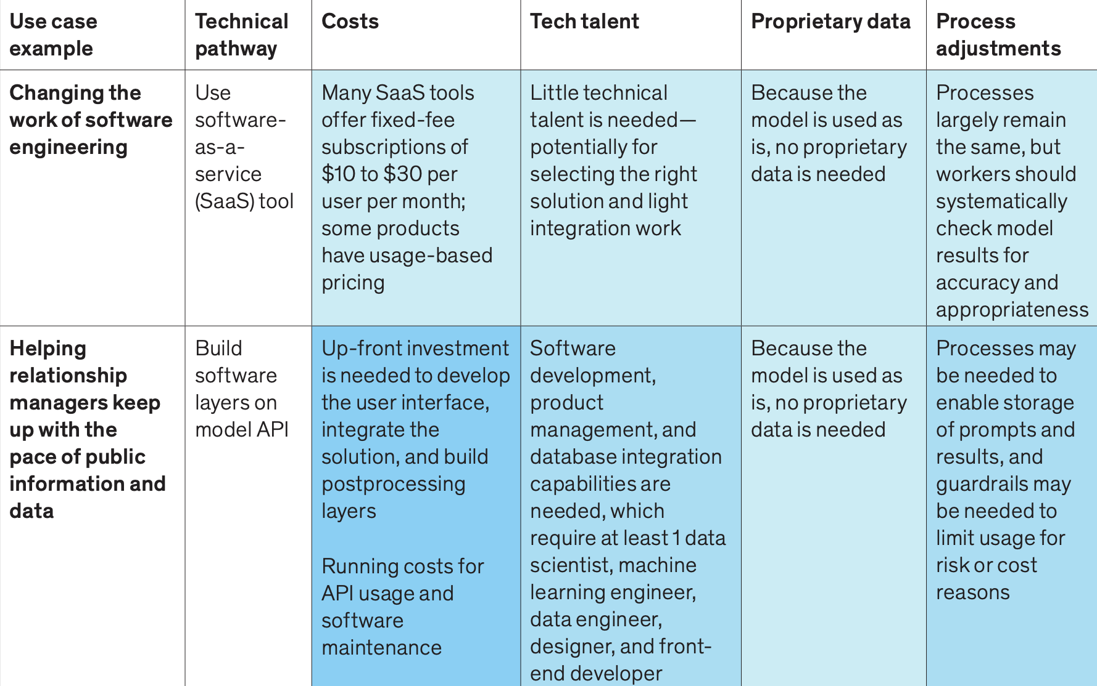

Incremental Changes - Low Effort Use Cases
(Effort)
Source: McKinsey, 2023
Notes:
https://www.mckinsey.com/il/~/media/mckinsey/business%20functions/mckinsey%20digital/our%20insights/what%20every%20ceo%20should%20know%20about%20generative%20ai/what-every-ceo-should-know-about-generative-ai.pdf

Slide 44
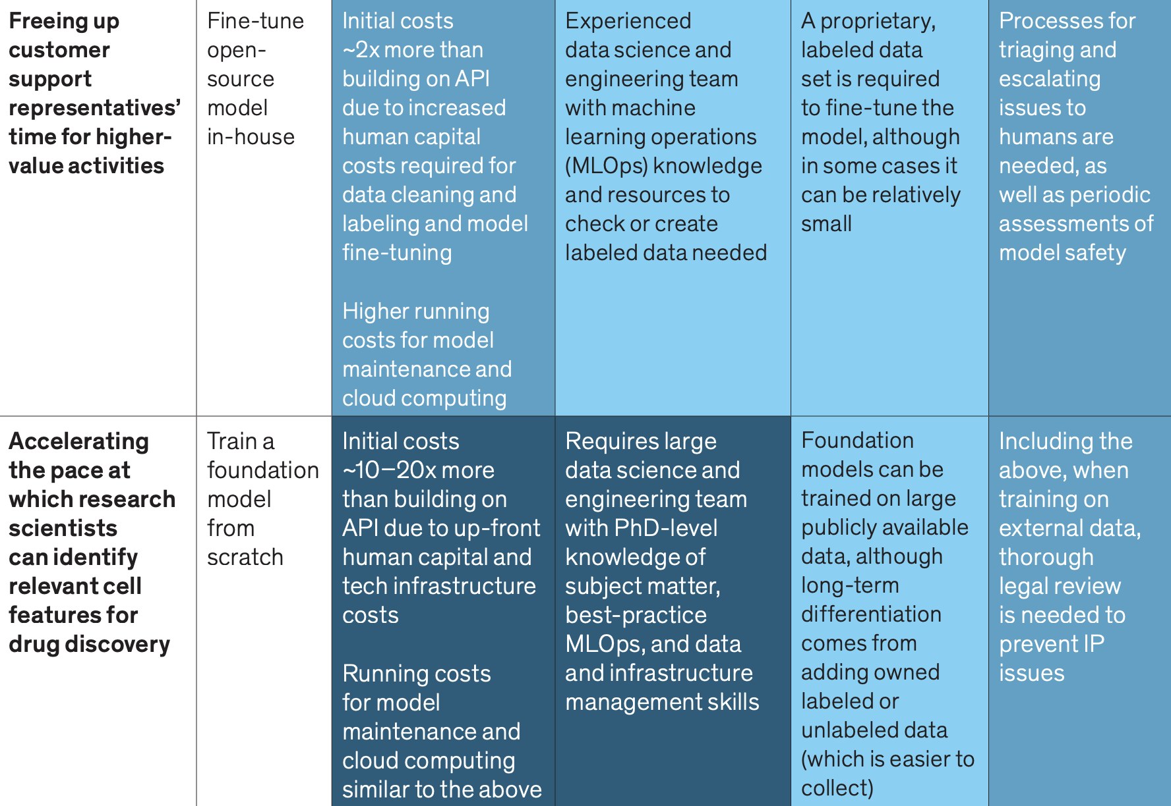
Transformational Changes - High Effort Use Cases
(Effort)
Source: McKinsey, 2023
Notes:
https://www.mckinsey.com/il/~/media/mckinsey/business%20functions/mckinsey%20digital/our%20insights/what%20every%20ceo%20should%20know%20about%20generative%20ai/what-every-ceo-should-know-about-generative-ai.pdf

Slide 45
Core AI Considerations in Feasibility
Talent: Do we have the skills (ML Engineers, Data Scientists, AI trained product devs) to execute?
USER NEEDS
(desirability)
BUSINESS GOALS
(viability)
Infrastructure: Does our existing infrastructure meet the AI requirements, if not what is the LOE to get there?
AI Performance requirements: With the existing capabilities and limitations of AI, is it even possible to reach the performance requirements?
ORGANIZATIONAL CAPABILITIES
(feasibility)
Notes:
PURPOSE:
Discuss the feasibility of AI projects in terms of talent, infrastructure, and AI performance requirements.
TALKING POINTS:
• Talent: Address the importance of having the right mix of skills within the team, including machine learning engineers, data scientists, and AI-trained product developers.
• Infrastructure: Examine whether our current technological infrastructure supports AI initiatives and the level of effort (LOE) required to bridge any gaps.
• AI Performance Requirements: Deliberate on the realistic expectations of AI performance given our existing capabilities and the technological limitations we may face.
TEACHING TIPS:
• Encourage a proactive approach to talent development, such as investing in training programs and considering partnerships with educational institutions.
• Discuss the scalability of infrastructure and the importance of planning for future needs as well as immediate requirements.
• Prompt participants to consider case studies where AI performance requirements were not met and the lessons learned from those experiences.

Slide 46
Incremental Changes - Low Effort Use Cases
(Effort)
Source: McKinsey, 2023
Notes:
https://www.mckinsey.com/il/~/media/mckinsey/business%20functions/mckinsey%20digital/our%20insights/what%20every%20ceo%20should%20know%20about%20generative%20ai/what-every-ceo-should-know-about-generative-ai.pdf

Slide 47
Transformational Changes - High Effort Use Cases
(Effort)
Source: McKinsey, 2023
Notes:
https://www.mckinsey.com/il/~/media/mckinsey/business%20functions/mckinsey%20digital/our%20insights/what%20every%20ceo%20should%20know%20about%20generative%20ai/what-every-ceo-should-know-about-generative-ai.pdf

Slide 48
AI for Leaders
GenAI &
Human Capital

Slide 49
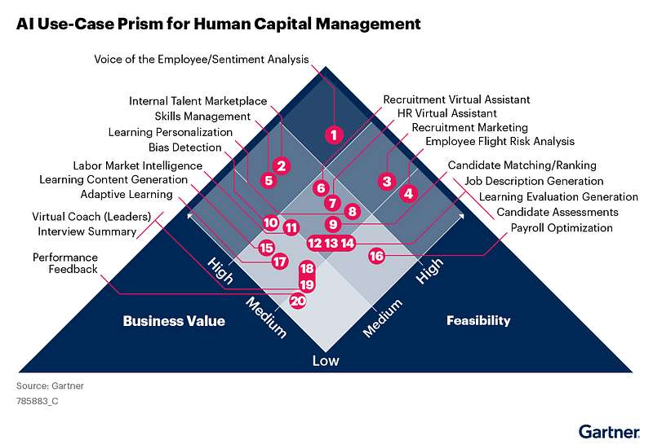
AI Use Cases in Human Capital
Source: Gartner August 2023

Slide 50
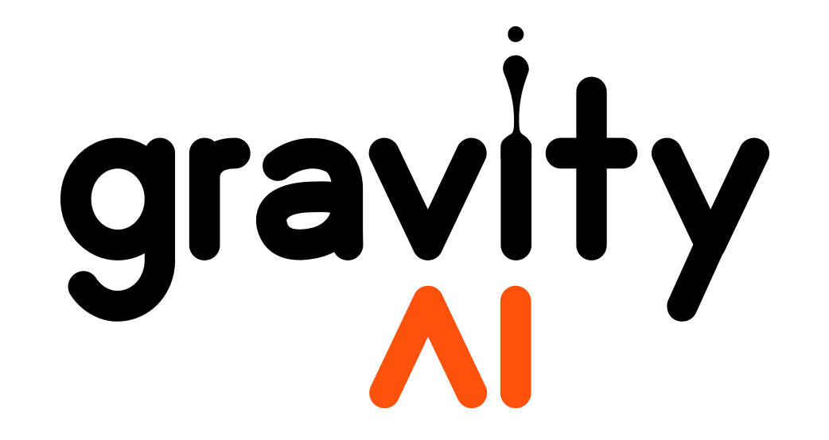
Live Demo: OnBoarding At gravityAI
Problem: How might we onboard new employees efficiently and provide a great experience?
Approach: A customized chat that answers employee questions, develops onboarding steps, and provides step by step onboarding instructions.
Technology: OpenAI, GPT4 - Custom GPTs functionality
Data & Configuration Required: Prompt writing, employee handbooks, onboarding PDFs, other documents.

Slide 51
Bringing it all together:
10 Minutes
Type your vote in the chat. (a,b, or c)
Vote on one of the USE CASES for GenAI in our field.
{Example Use-Case 1}
{Example Use-Case 2}
{Example Use-Case 3}
What DESIRABILITY, VIABILITY, FEASIBILITY considerations should we be evaluating?

Slide 52
What You Should do Next -
1
Build your Lighthouse
5
Organize a Cross-Functional Committee
2
Balance Risk & Value Creation
6
Build Partnerships in the Ecosystem
3
Enable a Fully Loaded Tech Stack
7
Refocus the Talent and Skills Gap
4
Domain Reimagining
vs. Single Use Cases
8
Deep Partnership with Assurance, Legal, & Compliance

Slide 53
Ask Us Anything!
Notes:
Following our AMA, we will hear some final words from Dr. Jeffrey Bergin, GA’s VP of Impact & Experience.

Slide 54
Bring it Home
A final word from Dr. Jeff Bergin
Notes:
some final words from Dr. Jeffrey Bergin, GA’s VP of Impact & Experience.

